Slide 1

Smart blind-stick

Slide 2


Abstract
The Smart Blind Stick project aims to develop an affordable and effective solution to enhance the mobility and independence of visually impaired individuals. This assistive device uses ultrasonic sensors to detect obstacles in real time, providing immediate feedback via a buzzer to help users avoid collisions and navigate safely. By leveraging Arduino microcontrollers and simple electronic components, the Smart Blind Stick offers a low-cost alternative to existing, expensive assistive technologies, ensuring accessibility for a broader population.
This Photo by Unknown Author is licensed under CC BY-SA-NC

Slide 3


Introduction
Visually impaired individuals often face significant challenges when navigating unfamiliar or crowded environments. Existing assistive devices, while helpful, are frequently cost-prohibitive for many users. The Smart Blind Stick is a cost-effective solution designed to address these mobility challenges. The device uses ultrasonic sensors to detect nearby obstacles and alerts the user through a buzzer, ensuring safer and more independent navigation. The project incorporates Arduino Uno/Nano microcontrollers, making it easy to develop and scale, and is designed to be lightweight and user-friendly. By providing immediate, real-time feedback, this device empowers visually impaired individuals with improved confidence and independence.

Slide 4

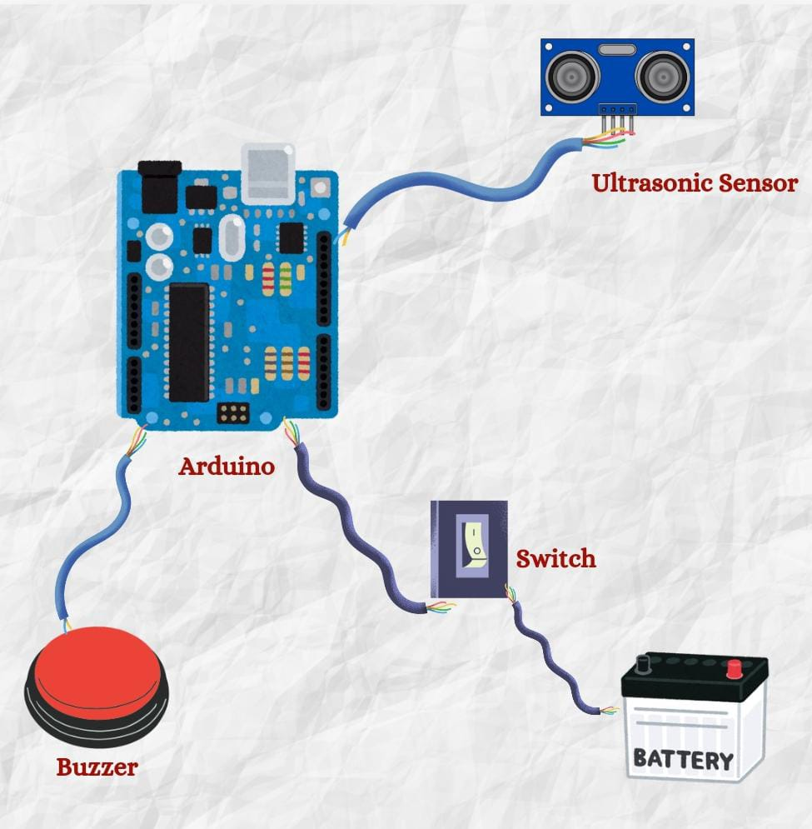

Proposed architecture diagram

Slide 5
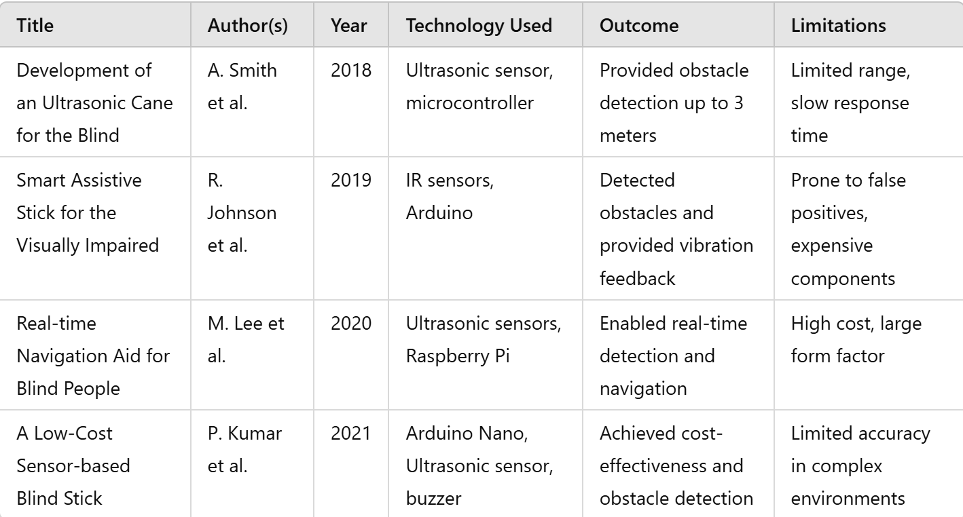
Literature survey

Slide 6
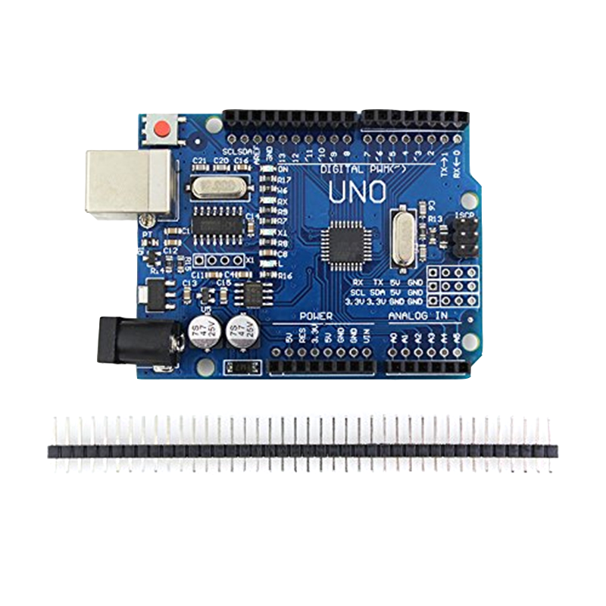
Limitations Identified from Literature Survey
Range Limitations: Several studies report limited obstacle detection range, which could hinder effective navigation in large or open areas.
False Positives: False alarms were identified as a significant issue due to sensor misinterpretation in cluttered environments.
Cost: Many solutions involve expensive or high-maintenance components, making them inaccessible to economically disadvantaged users.
Device Form Factor: Some existing solutions are bulky, reducing user comfort and practicality.

Slide 7

Research Objectives
Develop a cost-effective, portable, and reliable smart blind stick using readily available components.
Enhance the accuracy and range of obstacle detection using ultrasonic sensors to reduce false positives and ensure safety.
Provide immediate and clear feedback through a buzzer, allowing users to react promptly to obstacles.
Improve the form factor of the stick to ensure user comfort and easy adoption by visually impaired individuals.
Explore the integration of additional sensors or technologies to further enhance the device's functionality.

Slide 8
Thank you!
Dhruv Prajapati
Arth Joshi
Siddharth Sharma

